Slide 1

Detecting Malicious Hosts in SDN through System Call Learning
Authors: Christopher Mansour, Danai Chasaki
Presenting: Elad David, Inbar Shmaya

Slide 2
SDN’s abstraction
Source: Nick Mckeown, Stanford
Feature
Feature
Virtualization
Network OS
Feature
Feature
OS
Feature
Feature
OS
Custom Hardware
Feature
Feature
Custom Hardware
OS
Feature
Feature
Custom Hardware
OS
Custom Hardware
Feature
Feature
OS
Custom Hardware

Slide 3

The problem is…

Slide 4


Detection using Machine Learning (ML)
1
0
Application:
System calls
System calls analysis
1
0

Slide 5
0Why System Calls?
A malicious application is necessarily going to affect the flow of the system calls (number, type, order etc.).
There are many types of controllers; They all use system calls.
The SDN processing is centralized in the controller-OS.

Slide 6






Methodology
Controller
Using Linux utility strace
Docker Container
Docker Container
Docker Container
Docker Container
Docker Container
Docker Container
Clients
Virtual Host
Virtual Host
Web Server

Slide 7
Background: Machine Learning
Testing Data
Training Data
Learning Algorithm
Model
Predictable Result

Slide 8
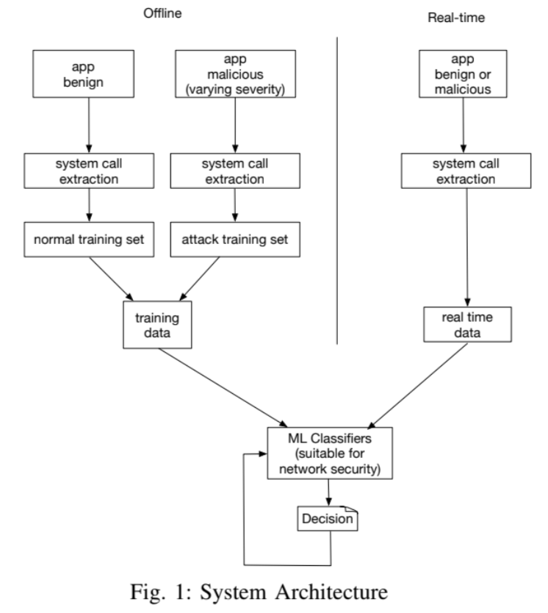

Slide 9
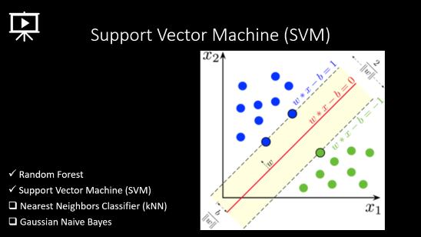
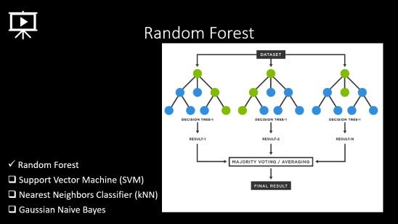
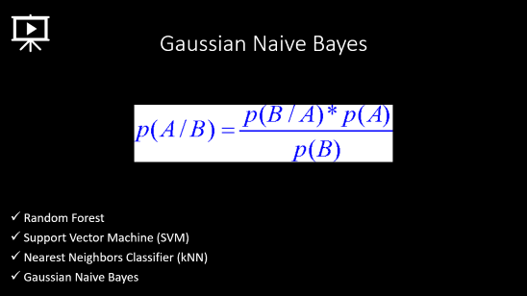
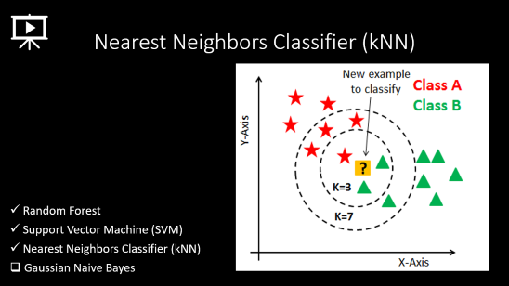
The chosen classification algorithms

Slide 10

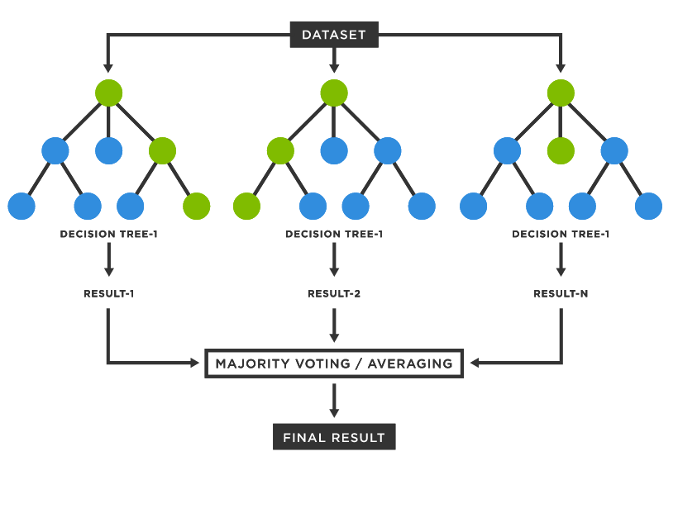
Random Forest
Random Forest
Support Vector Machine (SVM)
Nearest Neighbors Classifier (kNN)
Gaussian Naive Bayes

Slide 11
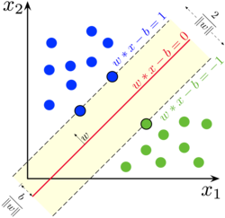
Support Vector Machine (SVM)
Random Forest
Support Vector Machine (SVM)
Nearest Neighbors Classifier (kNN)
Gaussian Naive Bayes

Slide 12
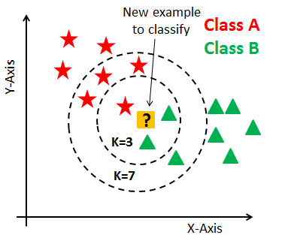
Nearest Neighbors Classifier (kNN)
Random Forest
Support Vector Machine (SVM)
Nearest Neighbors Classifier (kNN)
Gaussian Naive Bayes

Slide 13
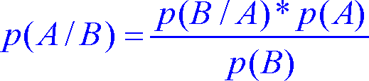
Gaussian Naive Bayes
Random Forest
Support Vector Machine (SVM)
Nearest Neighbors Classifier (kNN)
Gaussian Naive Bayes

Slide 14
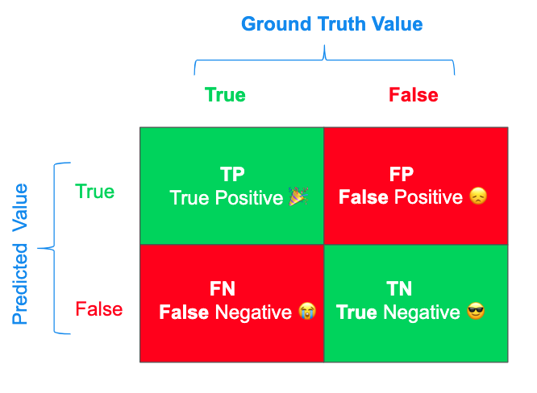
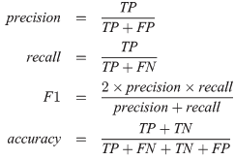
Evaluation using F1-score

Slide 16
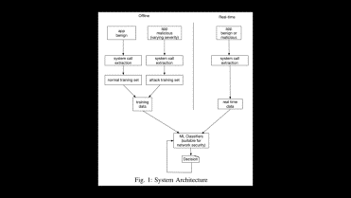
The experiment training scenarios
Malicious | Benign
1% | 99% | A
10% | 90% | B
25% | 75% | C

Slide 17
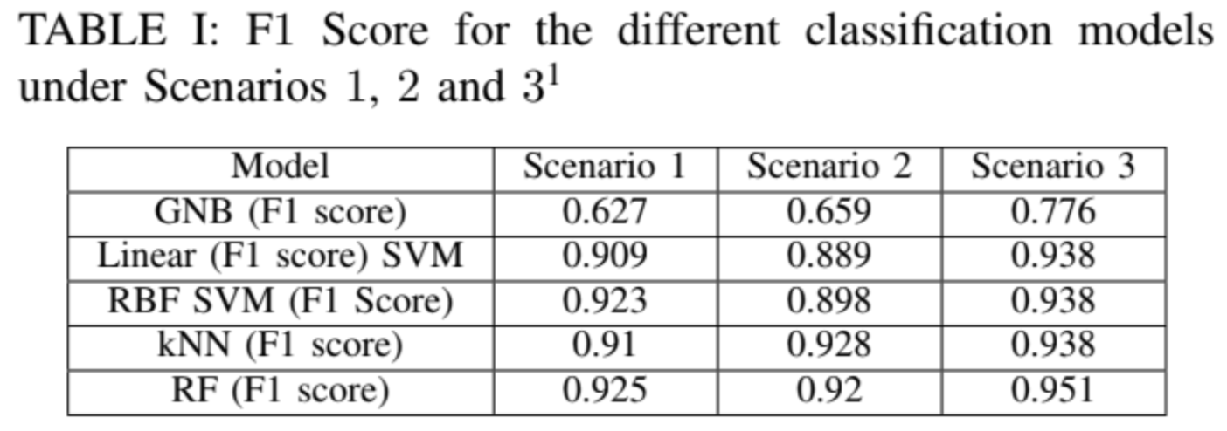

The results

Slide 18
Conclusions
It is efficient to use ML in order to identify malicious applications on SDN.
The Random Forest is the most accurate algorithm to use (out of the algorithms that had been conducted).

Slide 19

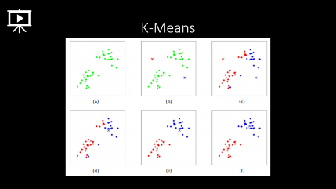
Our extension – ML improvements
Trace more malicious applications’ features:
Memory consumption
The response time of the controller
Detect suspicious access to files
Analyze the data with more ML classification algorithms:
K-Means (explained)
Logistic Regression
Decision tree

Slide 20
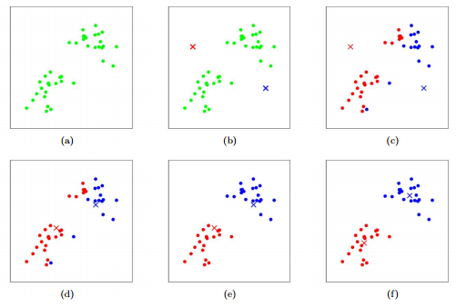
K-Means

Slide 21
References
“Detecting Malicious Hosts in SDN through System Call Learning”, Danai Chasaki, Christopher Mansour, 2021
“Software Defined Networking COMS”, Nick Mckeown, Stanford
“StatQuest: Random Forests Part 1 - Building, Using and Evaluating”, Josh Starmer, 2018
“How SVM (Support Vector Machine) algorithm works”, Thales Sehn Körting, 2014
“How kNN algorithm works”, Thales Sehn Körting, 2014
“Gaussian Naive Bayes, Clearly Explained!!!”, Josh Starmer, 2020
“StatQuest: K-means clustering”, Josh Starmer, 2018

Slide 22

Thank you for listening!
Elad David, Inbar Shmaya

